Slide 1
6G4Z0024 Web Development Lecture 4: Working with JavaScript
Ashley Williams
ashley.williams@mmu.ac.uk

Slide 2
Learning Objectives
To understand what JS is used for in web applications
To understand the importance of input validation and how it differs from verification
To understand what regular expressions are, when to use them and how to use them

Slide 3
Unit Structure
# | W/C | Lecture | Lab
1 | 24/1/22 | Intro to the Unit; History; How the web works; Intro to HTML | Basic HTML
2 | 31/1/22 | HTML Forms; Intro to CSS | HTML Forms; Basic CSS
3 | 7/2/22 | Layouts with HTML and CSS; Responsiveness; Intro to JS | CSS Layouts; Basic JS
4 | 14/2/22 | JS for performing basic tasks | Working with JS
5 | 21/2/22 | REST APIs; Dynamic pages with JS | Sending/Receiving HTTP requests with JS
6 | 28/2/22 | Assignment; Next Steps | Assignment Support

Slide 4
Last week recap
Responsive design – how we can ensure layouts are scalable across all devices and screensizes, using frameworks such as Flexbox
Dipping our toes into JavaScript

Slide 5
Questions?

Slide 6
Web sites vs Web applications
Note that I’ve started referring to our websites as applications..
What’s the difference between a website and web application?
Notes:
Website is a static set of documents which can be navigated using hyperlinks
Web applications are software that runs in the web browser. i.e. has some element of interactivity

Slide 7
Web sites vs Web applications
Websites are static sets of documents which can be navigated using hyperlinks
Web applications are software that runs in the web browser.
i.e. has some element of interactivity
Notes:
Website is a static set of documents which can be navigated using hyperlinks
Web applications are software that runs in the web browser. i.e. has some element of interactivity

Slide 8
JS – what is it good for?

Slide 9
What do we use JS for?
Input validation
Sending data to servers and handling responses
But also:
Animations
Enhancing the UI
Tracking traffic
Anything else?

Slide 10
Input validation
What is validation? How is it different to verification?
Notes:
Input validation is performed to ensure only properly formed data is entered
Verification involves checking that a user is who they say they are (ideally through multiple methods: login, text/email verification, biometrics)

Slide 11
Validation and Verification
Validation: is the input correct?
Has the user entered a string with less than 10 characters?
Has the user entered a valid email address?
Does the password adhere to our complexity rules?
Verification: is the user who they say they are?
Ideally, we would check through multiple methods:
Login
Text/email verification
Biometrics (e.g. fingerprints, face)

Slide 12
Where does validation happen?
Programming should be done defensively:
Defensive Programming: always assume that the function is being called incorrectly, and check everything
How?
Check all preconditions and assumptions (e.g. your function accepts an email as a parameter – double check that it is text, and a valid email, and has actually been provided.
Does your function call another function? You know that it returns a Boolean value, but double check – just in case something changes in the future.
Be paranoid! Somebody is going to break your code eventually!

Slide 13
Where does validation happen?
Validation should take place multiple times throughout the workflow
Imagine a login form on a website:
HTML
(input types, required, max/min values, formats)
User clicks the submit button – executes a JS function
JS
(check all the input, are required fields present? Is the input all correct?)
Input is ok, JS sends request to server
Server
(check all the input again!)

Slide 14
Where does validation happen?
Validation should take place multiple times throughout the workflow
Imagine a login form on a website:
HTML
(input types, required, max/min values, formats)
User clicks the submit button – executes a JS function
JS
(check all the input, are required fields present? Is the input all correct?)
Input is ok, JS sends request to server
Server
(check all the input again!)
If everything has worked, feedback is provided to the user
Server sends response, the JS function double checks that the response is correct

Slide 15
Validating input with JS
So, how do we actually validate form data with JS?
Design our form in HTML
Have our form execute a JS function when submitted
Get the data from the form
Check that the data is correct
Do something (e.g. send to a server, handle the error)

Slide 16

Validating input with JS
So, how do we actually validate form data with JS?
Design our form in HTML
Have our form execute a JS function when submitted
Get the data from the form
Check that the data is correct
Do something (e.g. send to a server, handle the error)

Slide 17
Regular Expressions
Patterns used to match character combinations in strings
Have lots of uses in SE. One key use is that they can be used to check that form input fields are formatted correctly
The patterns are stored in a variable. You denote a RegEx pattern by wrapping in forward slash’s
You can check that a string conforms to a RegEx pattern using the test() function

Slide 18
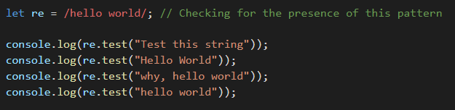
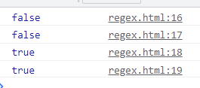
Regular Expressions: Example
Pattern is stored in the re variable
The pattern is tested against four strings and written to the console
Case sensitive

Slide 19

Regular Expressions: What can they do?
^The – matches any string that starts with ‘The’
end$ - matches any string that ends with ‘end’
^The end$ - matches the exact string ‘The end’
[a-z] – any lowercase letter
+ - one or more
Therefore, what about this pattern:
Notes:
Match any string made up of only lower case characters

Slide 20
Regular Expressions: What can they do?
^The – matches any string that starts with ‘The’
end$ - matches any string that ends with ‘end’
^The end$ - matches the exact string ‘The end’
[a-z] – any lowercase letter
+ - one or more
Therefore, what about this pattern:
Match any string made up of only lower case characters
Notes:
Match any string made up of only lower case characters

Slide 21
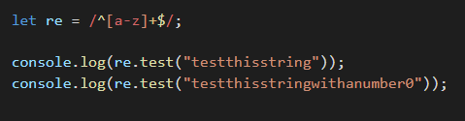

Regular Expressions: What can they do?

Slide 22
Regular Expressions: What can they do?
We can also have:
* - zero or more
[0-9] – numerical digits
[A-Z] – capital letters
Therefore, what about this pattern:
Notes:
Match any string made up of only lower case characters

Slide 23
Regular Expressions: What can they do?
We can also have:
* - zero or more
[0-9] – numerical digits
[A-Z] – capital letters
Therefore, what about this pattern:
Match any string made up of zero or more letters or numbers (allows upper and lower case)
Notes:
Match any string made up of only lower case characters

Slide 24
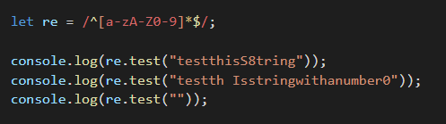
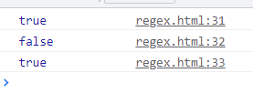
Regular Expressions: What can they do?

Slide 25
Regular Expressions: What can they do?
We can also have:
? - zero or one
abc{2} – ab followed by exactly 2 c’s
abc{2, 5} – ab followed by between 2 and 5 c’s
Therefore, what about this pattern:
Notes:
Match any string made up of only lower case characters

Slide 26
Regular Expressions: What can they do?
We can also have:
? - zero or one
abc{2} – ab followed by exactly 2 c’s
abc{2, 5} – ab followed by between 2 and 5 c’s
Therefore, what about this pattern:
One or two letters
One or two numbers
Space
One number
One or two letters
Notes:
Match any string made up of only lower case characters

Slide 27
Regular Expressions: What can they do?
We can also have:
? - zero or one
abc{2} – ab followed by exactly 2 c’s
abc{2, 5} – ab followed by between 2 and 5 c’s
Therefore, what about this pattern:
A.K.A … a postcode
Notes:
Match any string made up of only lower case characters

Slide 28
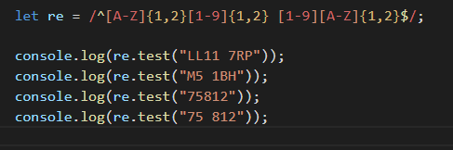
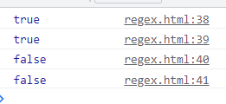
Regular Expressions: What can they do?
Notes:
Match any string made up of only lower case characters

Slide 29
Regular Expressions: What about this?
^[a-zA-Z0-9.!#$%&'*+/=?^_`{|}~-]+@[a-zA-Z0-9](?:[a-zA-Z0-9-]{0,61}[a-zA-Z0-9])?(?:\.[a-zA-Z0-9](?:[a-zA-Z0-9-]{0,61}[a-zA-Z0-9])?)*$

Slide 30
Regular Expressions: What about this?
^[a-zA-Z0-9.!#$%&'*+/=?^_`{|}~-]+@[a-zA-Z0-9](?:[a-zA-Z0-9-]{0,61}[a-zA-Z0-9])?(?:\.[a-zA-Z0-9](?:[a-zA-Z0-9-]{0,61}[a-zA-Z0-9])?)*$
It’s an email address
RegEx’s can get very complicated.
Often you can Google patterns you want (that’s how I got this RegEx)
This pattern still won’t work on all email addresses – there are external libraries you can use for validating email properly

Slide 31
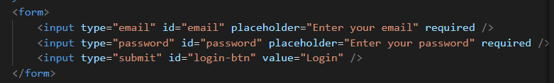
Using regular expressions to validate form input

Slide 32
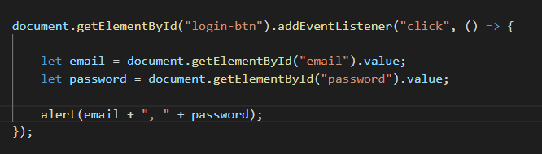
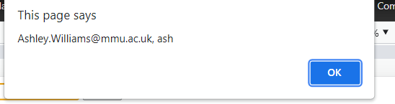
Using regular expressions to validate form input
Add the event listener on the button click
Note the “value” to get the form contents

Slide 33
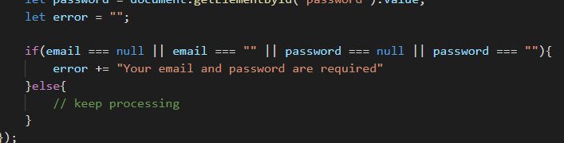
Using regular expressions to validate form input
Add a variable to store any error messages
Check that email and password exist

Slide 34
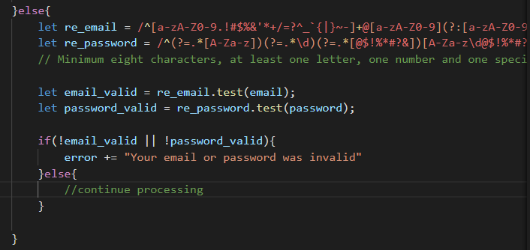
Using regular expressions to validate form input
Test email and password against your RegEx (note the password RegEx)
If either don’t pass, add to the error message

Slide 35

Using regular expressions to validate form input
All is good, send to the server…
We will be doing this next week, for now we just print to the console.
e.preventDefault() stops the form from refreshing the page

Slide 36
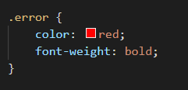
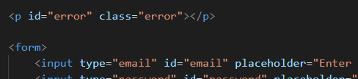
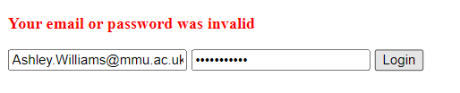

Using regular expressions to validate form input
For handling errors, we add an empty <p> to our form
Whenever we detect an error, we update the innerHTML of the error <p>
We apply a style to make it stand out
Again, we prevent the form from refreshing

Slide 37
This week's lab
Catch up on previous labs – focus on those that are relevant to the assignment (has anyone kept up with all labs?)
Improve your JS understanding (important for assignment, future units, and anything you do in web)
Practice using regular expressions for validating form input

Slide 38
Questions?

Slide 39
Sources
https://medium.com/swlh/2-defensive-coding-techniques-you-should-use-today-4225cacc1c29
https://developer.mozilla.org/en-US/docs/Web/JavaScript/Guide/Regular_Expressions
https://medium.com/factory-mind/regex-tutorial-a-simple-cheatsheet-by-examples-649dc1c3f285
https://stackoverflow.com/questions/201323/how-can-i-validate-an-email-address-using-a-regular-expression

